Slide 1
Capstone Project - 4
Online Retail Customer Segmentation
Prepared By
Nitin Solanki
(solankinitin1210@gmail.com)

Slide 2
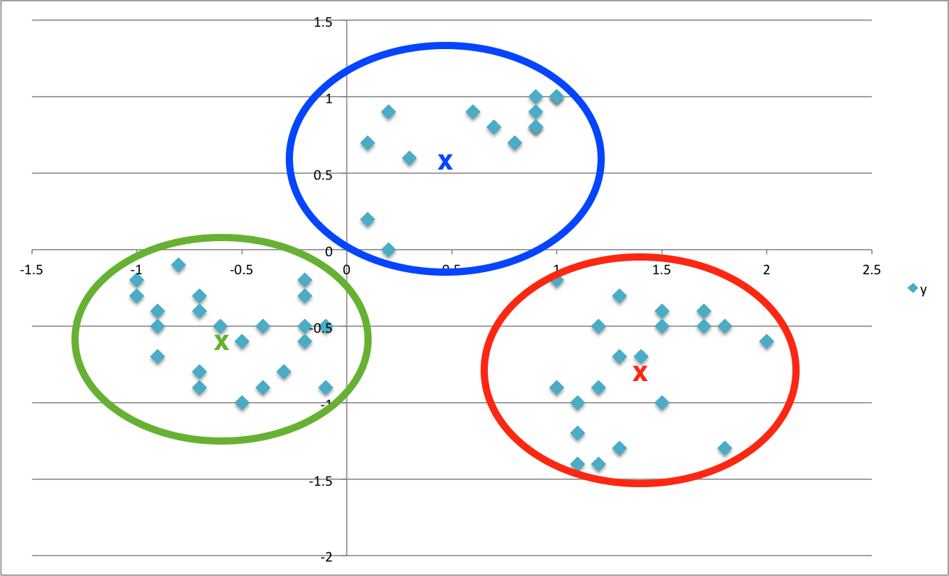
Content
PROBLEM STATEMENT
DATA SUMMARY
ANALYSIS
CHALLENGES
CONCLUSION
Q & A

Slide 3
Problem Statement
Given a dataset related to a online retailer based out of the UK, we need to analyse and identify major customer segments using K Means algorithm and also using different verification method to confirm the result.

Slide 4
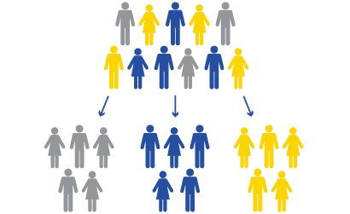
What is Customer Segmentation?
Practice of dividing a customer base into groups of individuals that are similar in specific ways relevant to marketing, such as age, gender, interests and spending habits.
Allows us to better understand our customers helping us target these customers in a more efficient manner and improve the customer experience.

Slide 5
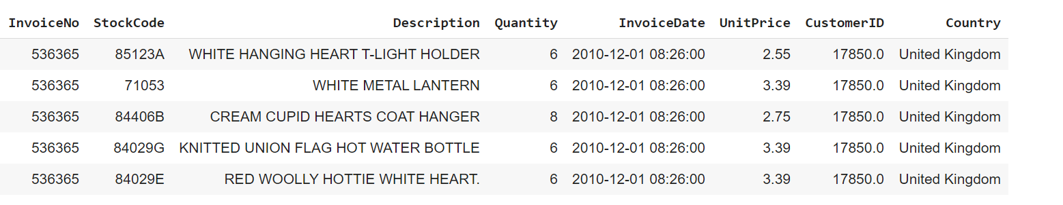
Data Summary
A transnational data set with transactions occurring between 1st December 2010 and 9th December 2011 for a UK-based online retailer.
The company mainly sells unique all-occasion gifts.
Many customers of the company are wholesalers.

Slide 6
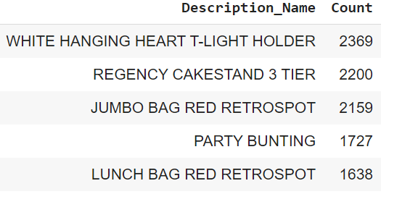
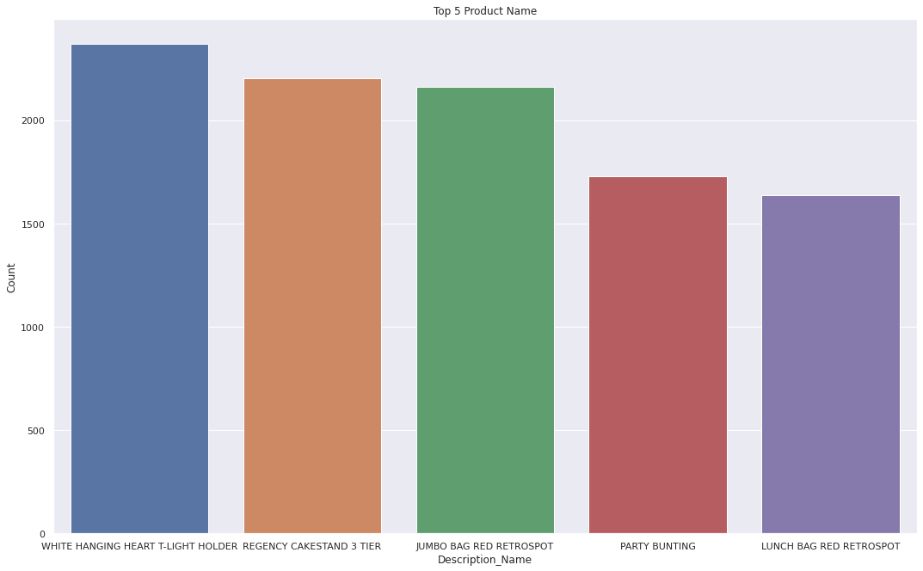
Cleaning Data Finding the most Purchased Products

Slide 7
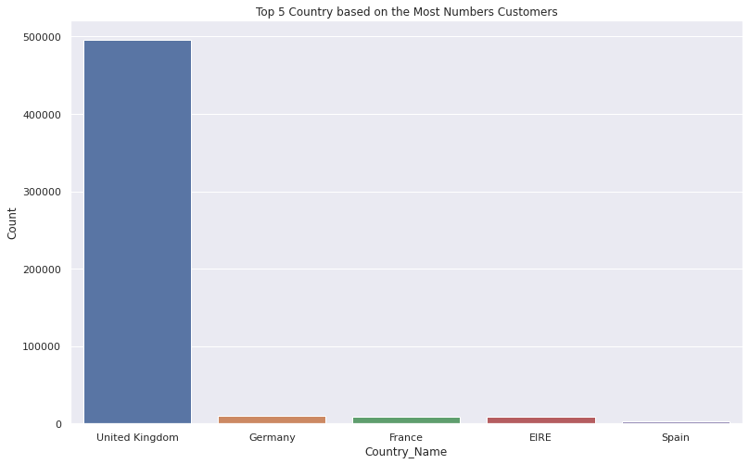
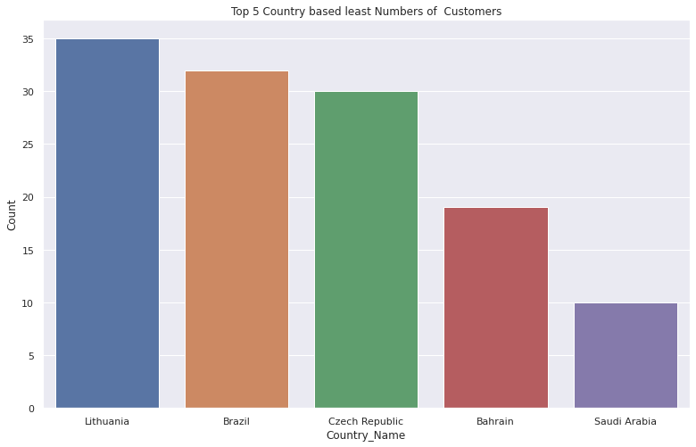
Top 5 vs Bottom 5 countries

Slide 8
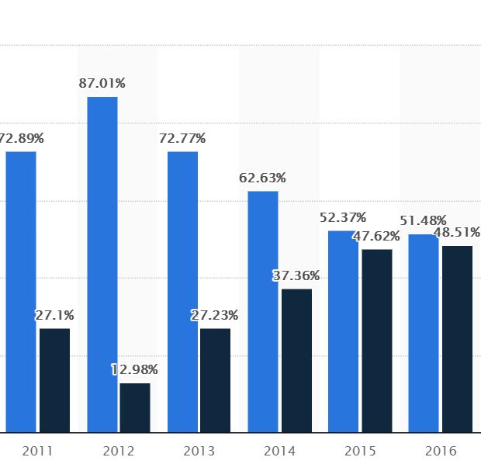
Analysis
UK
Saudi
Source obtained from Statista comparing online purchases from 2011 to 2016

Slide 9
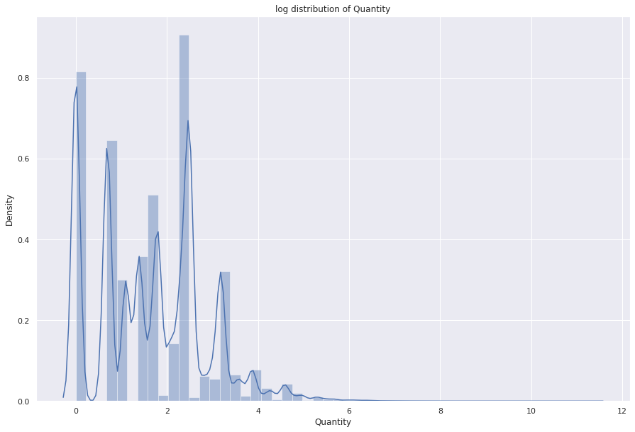
Log Distribution of Quantity

Slide 10
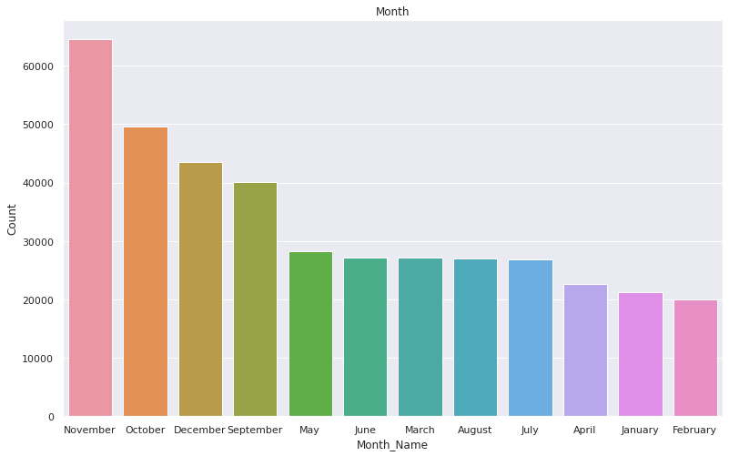
Month-wise analysis
November and December could be the months with highest sales in anticipation of Christmas

Slide 11
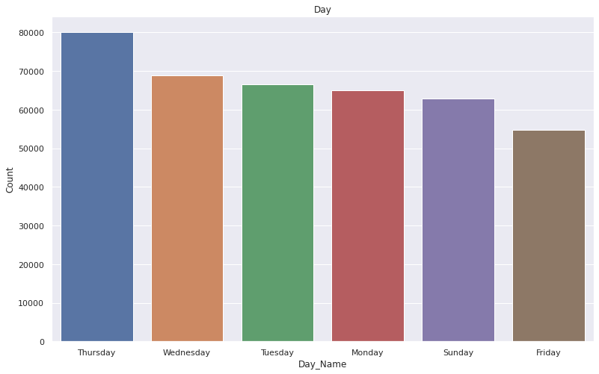
Daywise analysis

Slide 12
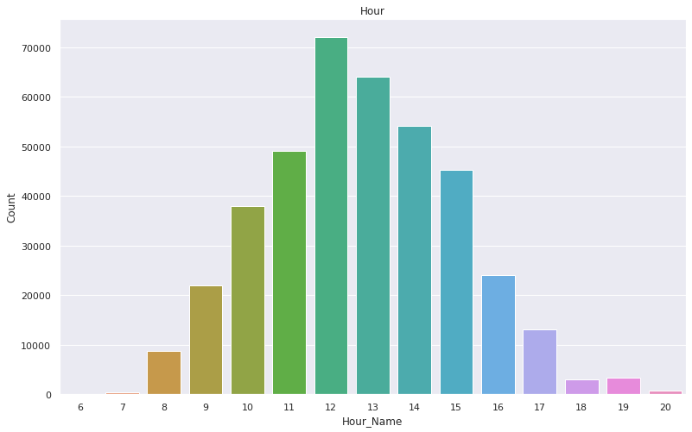
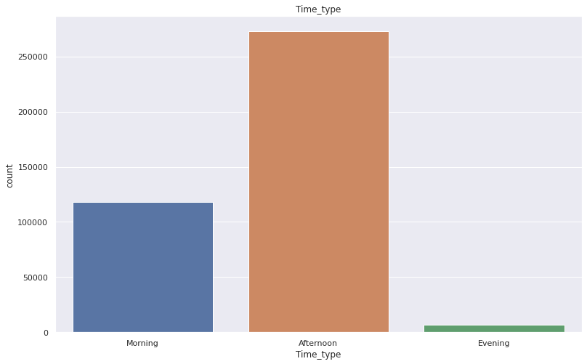
Hourwise analysis
Working hours witnessing the highest sales could be attributed to the fact that a large part of the dataset is Wholesalers’ data

Slide 13
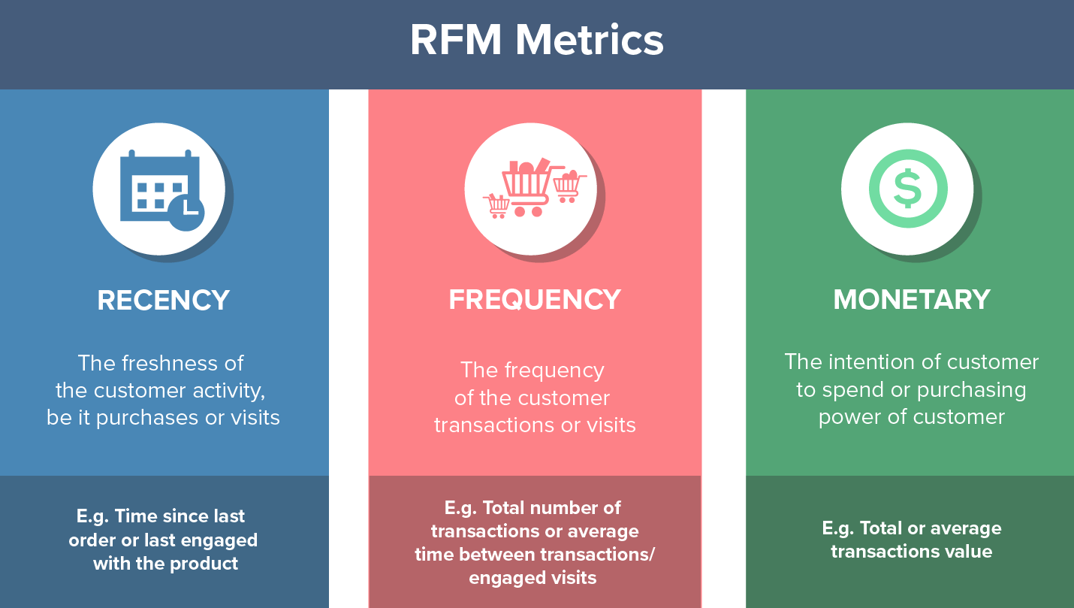
Recency,Frequency,Monetary values

Slide 14
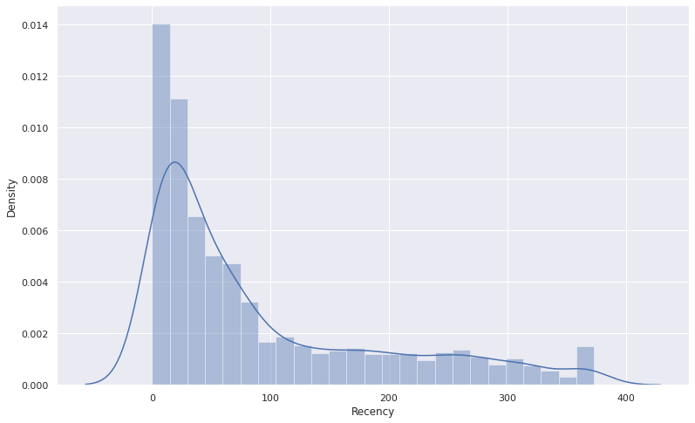
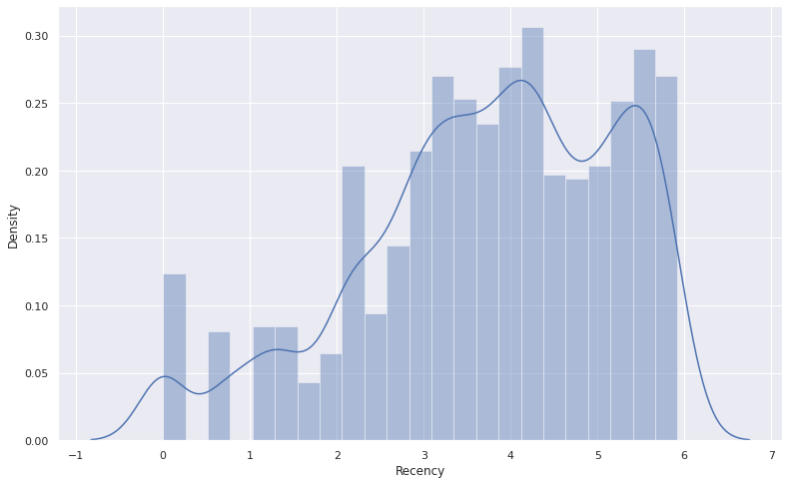
Recency

Slide 15
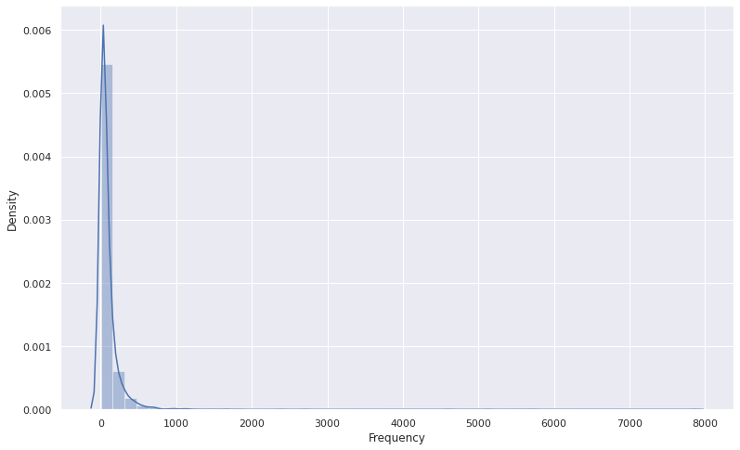
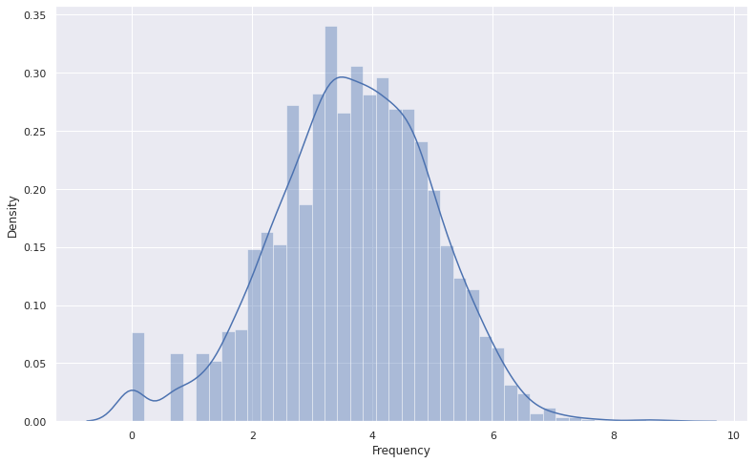
Frequency

Slide 16
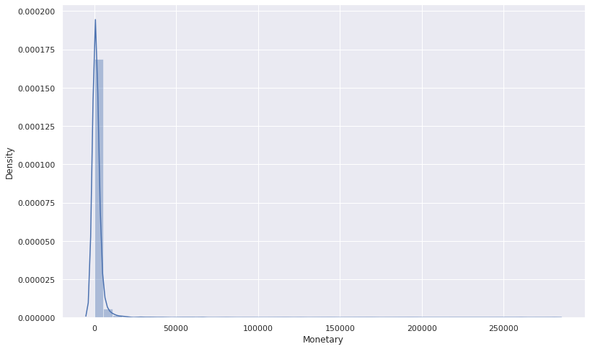
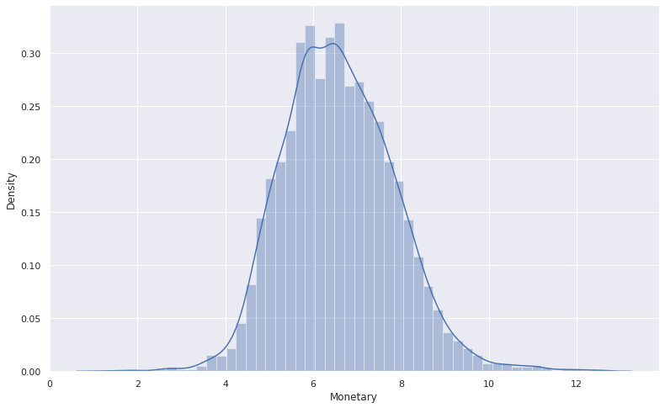
Monetary

Slide 17
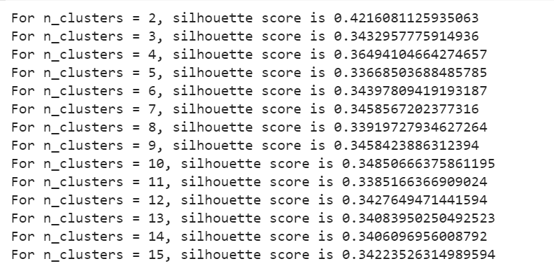
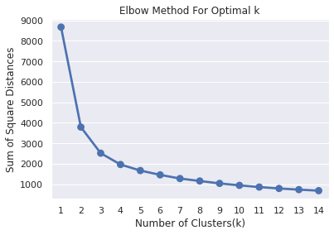
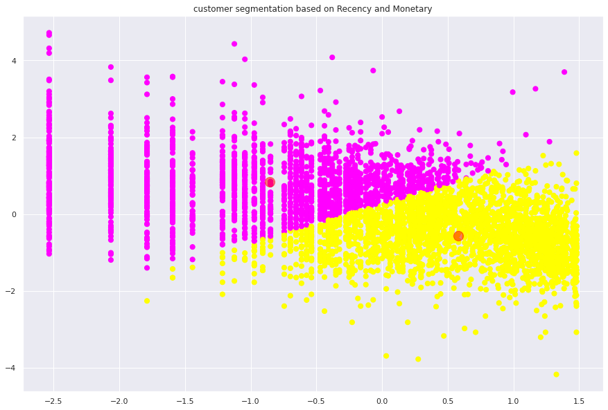
Silhouette score and Elbow method on R&M

Slide 18
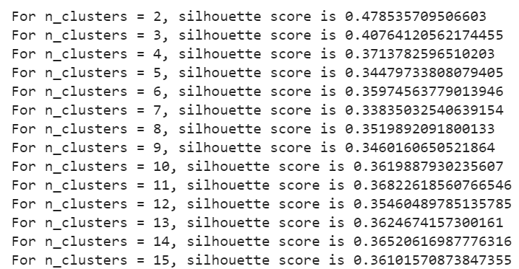
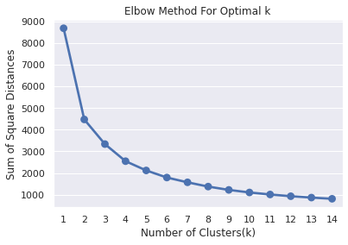
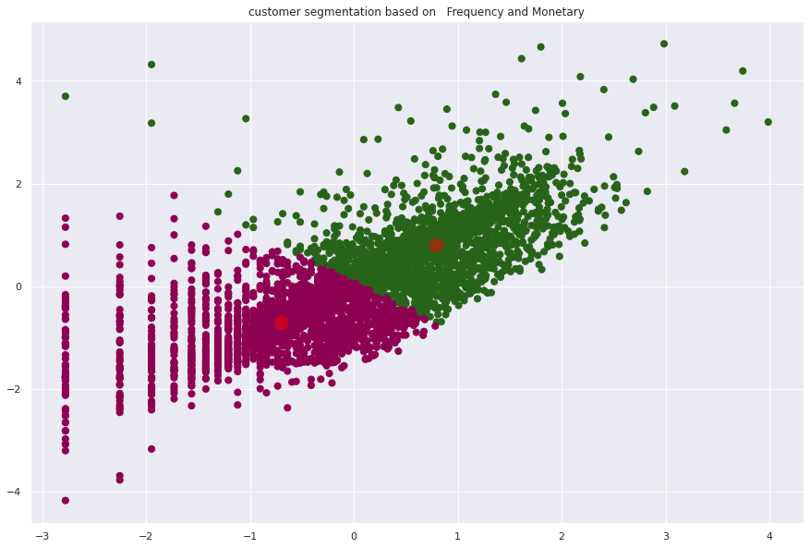
Silhouette score and Elbow method on F&M

Slide 19
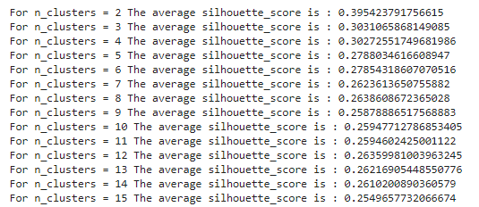
Silhouette analysis on R, F and M

Slide 20
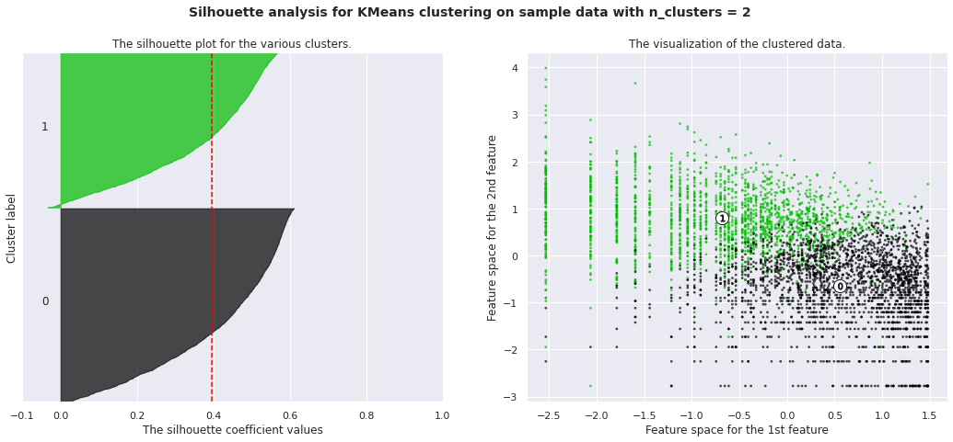
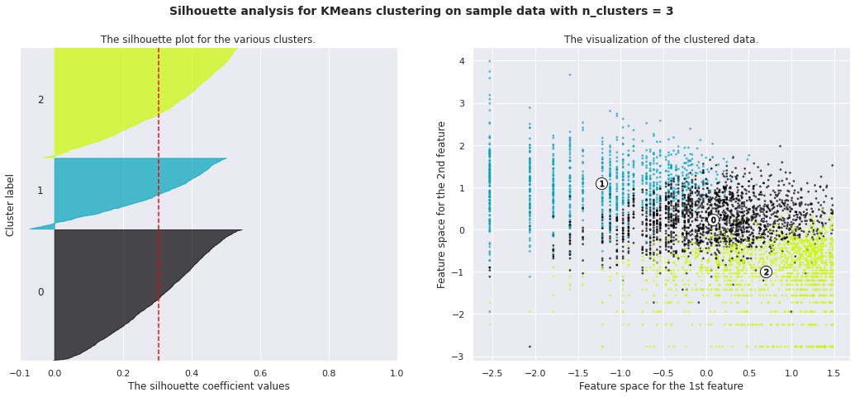
Silhouette analysis on RFM

Slide 21
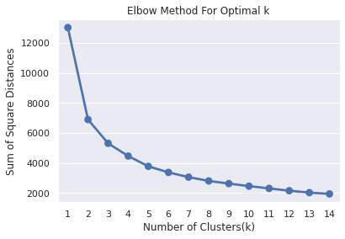
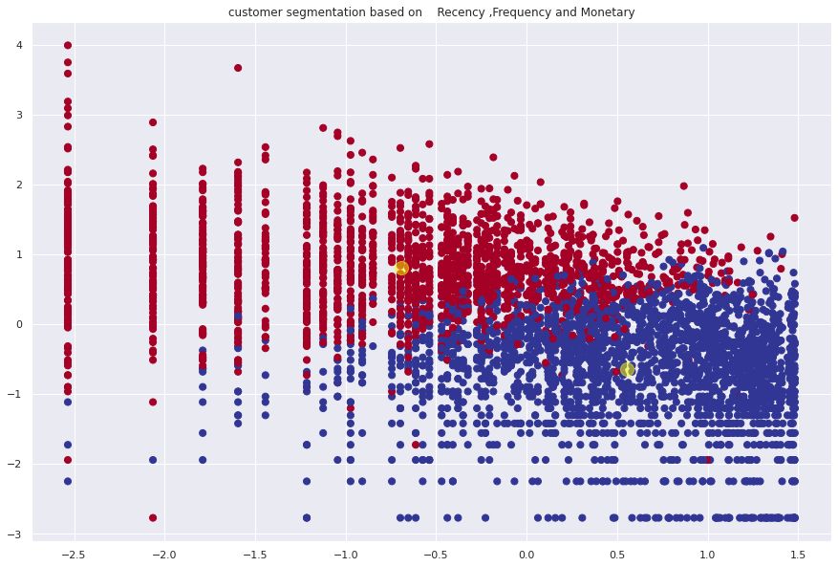
Elbow method and Cluster chart on RFM

Slide 22
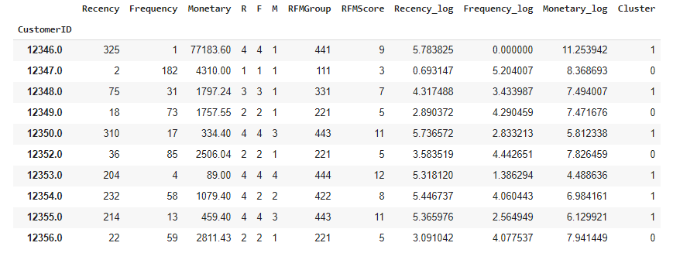
RFM Analysis

Slide 23
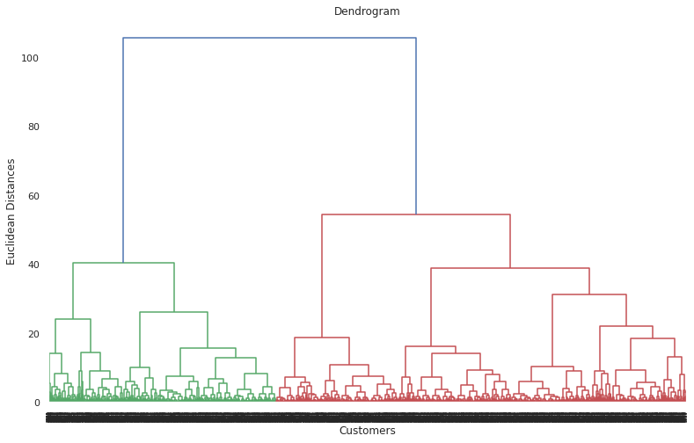
Dendrogram

Slide 24
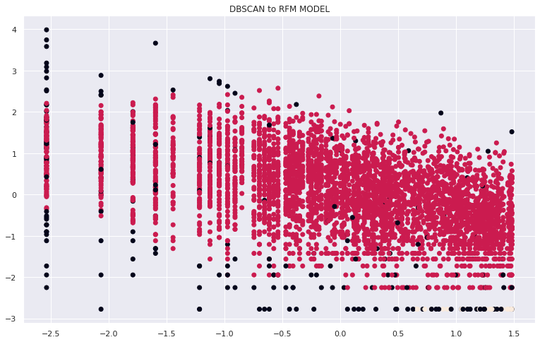
DBSCAN

Slide 25
Challenges
Tackling refunds
Right number of ‘k’ for clusters

Slide 26
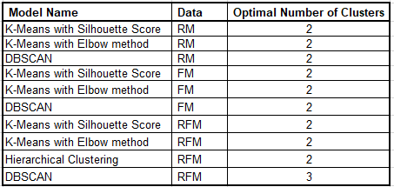
Conclusion

Slide 27
Q & A

